Slide 1
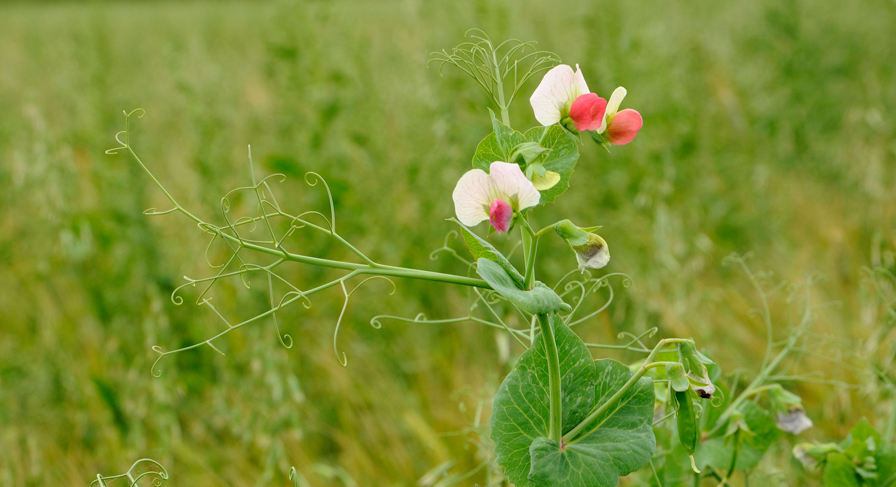

The Work of Gregor Mendel
Notes:
Read the lesson title aloud to students.

Slide 2
Learning Objectives
Explain from where an organism gets its unique characteristics.
Explain how different forms of a gene are distributed to offspring.
Notes:
Click to reveal each of the learning objectives in turn.
Show students a picture of a large family that includes at least two generations. Ask students to list some physical characteristics that the younger family members likely inherited from their parents or grandparents. Invite volunteers to share one or two items on their list. Then encourage students to share their ideas about the inheritance of traits.

Slide 3
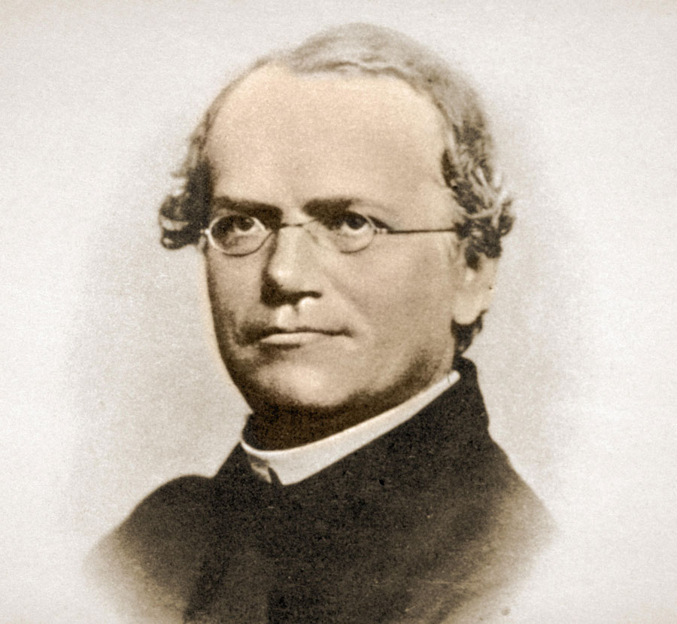
Mendel’s Experiments
Peas are a “model system.”
Started with “true breeding” plants
Trait: specific characteristic (e.g., seed color, plant height) of an individual
Hybrid: created from cross of true-breeding individuals
Notes:
Explain that back in the early 19th century, no one could describe exactly why offspring of plants and animals looked like their parents, and why traits seemed to appear and disappear and reappear again down through generations.
Introduce Gregor Mendel as a monk who was born in 1822. He spent a great deal of time in the monastery garden where he was able to carry out experiments into inheritance. He chose to work with peas, which are small and easy to grow, and produce large number of offspring.
Click to reveal first bullet.
Ask: Why do you think inheritance studies using peas is preferable to using species like pigs or horses?
Point out that the plants Mendel started with were true breeding strains. Describe how true breeding strains are created.
Click to reveal second and third bullets.
Explain that Mendel’s different groups of true-breeding plants would produce the same set of traits in each generation. To figure out how traits were inherited from one generation to the next, Mendel crossed individuals from his true-breeding strains to produce hybrids.
Click to reveal fourth bullet.

Slide 4
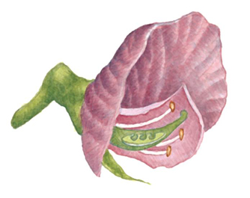
Pollination in Pea Plants
Male part
Female part
Notes:
Ask students to describe the general process of pollination in plants. Point out that pea plants also have the ability to self-pollinate, meaning a single individual can produce offspring.
Explain that, although Mendel did not have our modern understanding of genes and alleles, he did understand that male parts of a flower produce male sex cells (sperm) and that female parts of a flower produce female sex cells (eggs), and that these cells join in the process fertilization. Be sure students understand the difference between pollination and fertilization.
Misconception Alert: Students may think that self-pollination is a form of asexual reproduction. Explain that, while offspring are produced from only one parent, each offspring forms from the fusion of male and female cells.

Slide 5
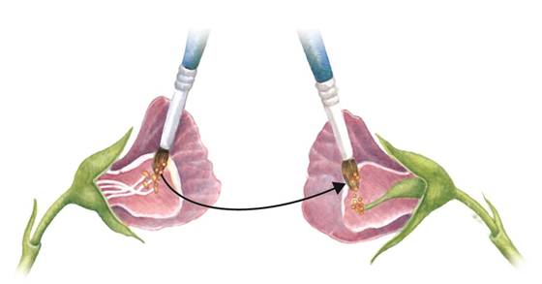
Cross-Pollination
Pollen
Notes:
Ask students to describe what they notice about the flowers shown here compared to the flower on the last slide. Guide them to realize that in the last slide the flower had both male and female structures. Here, the flowers have only male or female structures.
Explain that Mendel removed reproductive structures from pea flowers so that only one set remained.
Ask: What do you think Mendel was trying to prevent by removing one set of reproductive structures? Why?
Answer: He was trying to prevent the flowers from self-pollinating. He wanted to be able to control which plants were being crossed.
Explain that the diagram shows the method Mendel used to cross pea plants. Ask a volunteer to describe what the figure is showing.

Slide 6
Pea Characteristics
Notes:
Point out that Mendel was looking at seven characteristics in pea plants. His goal was to look for patterns in the traits across generations.
Misconception Alert: Emphasize to students that in Mendel’s day, the terminology we use of genes, alleles, and chromosomes was unknown.

Slide 7
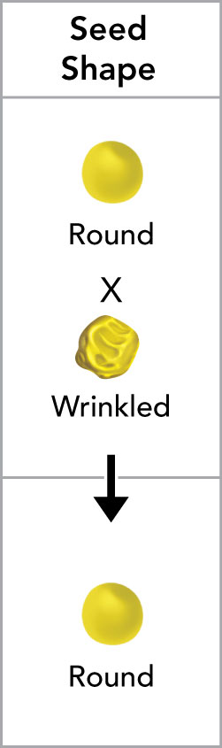
Genes and Alleles
Genes: passed from one generation to the next; determine an individual’s characteristics
Alleles: the different forms of a gene
Characteristics such as seed color
are determined by .
Yellow and green seed colors are
determined by .
The allele for yellow seeds is
to the allele for green.
genes
alleles
dominant
Notes:
Emphasize that Mendel’s first conclusion from his experiments was that an individual’s characteristics are determined by factors that are passed from one parental generation to the next.
Explain that today we can talk about genes that govern particular characteristics and the different alleles that control the different versions of those characteristics. But for Mendel, he could consider only the traits themselves. What he called factors, today we call “genes.” The different versions of a gene that produce the different traits (for example, yellow seeds versus green seeds) are called alleles.
Ask students to consider the characteristic shown here (seed color) in terms of genes and alleles.
Click to reveal three sentences and three blanks.
Have volunteers fill in the blanks by responding verbally.
Click to reveal the correct answers.
Explain how some traits show a pattern of dominance, “masking” another, recessive, trait.
Challenge students to think like Mendel. Ask them to imagine they crossed two plants: one with green seeds and one with yellow. The offspring of the plant produced only yellow seeds. Ask them what they could infer about the green and yellow seed color traits.
Ask: How would the results of the cross change if green seed color were dominant to yellow seed color?
Answer: The offspring of a green-yellow cross would have green seeds.
Misconception Alert: Students may sometimes get the impression, when considering traits such as pod color, seed color, or seed shape, that the structures themselves are somehow being “crossed.” Remind students that these structures are traits of full plants, and that the results of the crosses refer to the traits shown by the offspring plant.

Slide 8
Principle of Dominance
Some alleles are dominant, some recessive.
An organism with at least one dominant allele will exhibit that trait.
An organism with a recessive allele will exhibit the trait only in the absence of a dominant allele.
Notes:
Explain that Mendel’s second conclusion is called the principle of dominance.
Read the first bullet point aloud. Ask for a volunteer to explain what is meant by the terms “dominant” and “recessive.”
Click to reveal the second bullet and ask a student to read it aloud.
Click to reveal the third bullet and ask a different student to read it aloud.

Slide 9
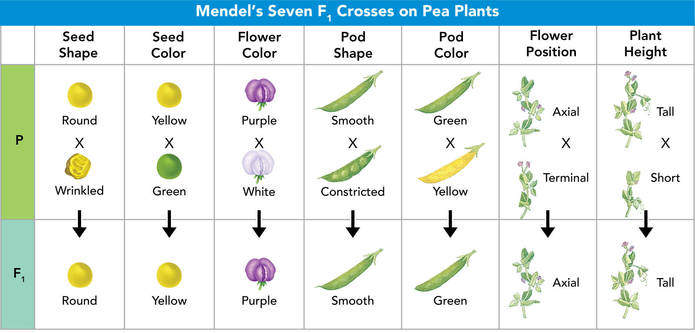
Mendel’s F₁ Crosses
When Mendel crossed plants with contrasting traits, the hybrid offspring showed traits of only one parent.
Notes:
Step students through the figure, describing the results of crosses of plants with contrasting traits for a given feature.
Ask: What does it mean for the trait of roundness to be to be dominant in the F1 generation?
Answer: If a plant has one allele for round and one for wrinkled, the offspring will have a round seed shape.
Challenge students to figure out the pattern that Mendel saw for the F1 generation.
Ask: What pattern do you see in the offspring?
Answer: All offspring had traits of only one parent.
Click to reveal the statement summarizing Mendel’s findings.

Slide 10
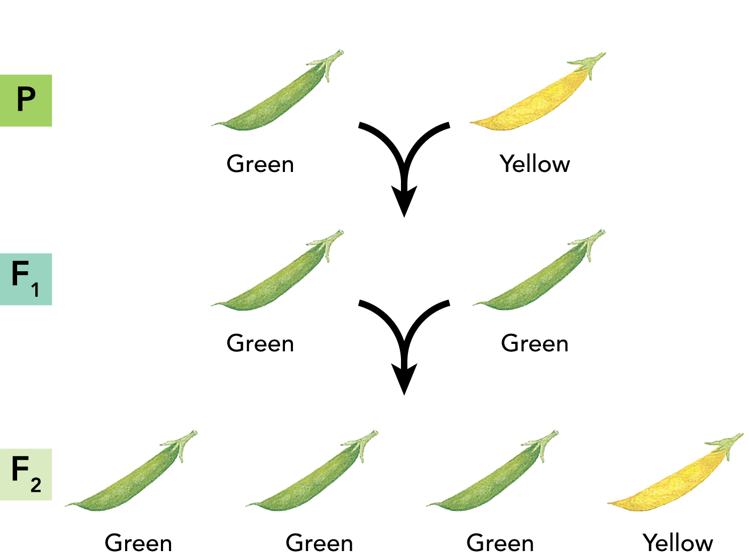
Segregation
Segregation: separation of alleles during gamete formation
Notes:
Explain that even though Mendel was able to reach two conclusions from his initial experiments, he still wanted to know what happened to traits that seemed to disappear from one generation to the next. In particular, he wanted to know if recessive factors (alleles) had disappeared or were still present in offspring with a dominant trait.
Walk students through the crosses shown in the diagram. Make sure they understand that the yellow trait reappeared because the F1 generation had both green and yellow alleles.
Ask: Why didn’t the allele for yellow color show in the F1 generation?
Answer: The yellow allele is recessive. It was masked by the dominant allele for green color.
Ask: Was the recessive allele for yellow color lost in the F1 generation? How do you know?
Answer: No, it reappeared in the F2 generation.
Explain that from this result Mendel was able to infer that the factors controlling traits do not blend or become last within an individual but that they remain separate. This led him to conclude that when that individual them produces gametes (sex cells) those distinct traits segregate and can move into anther generation where they may or may not be expressed in offspring.

Slide 11
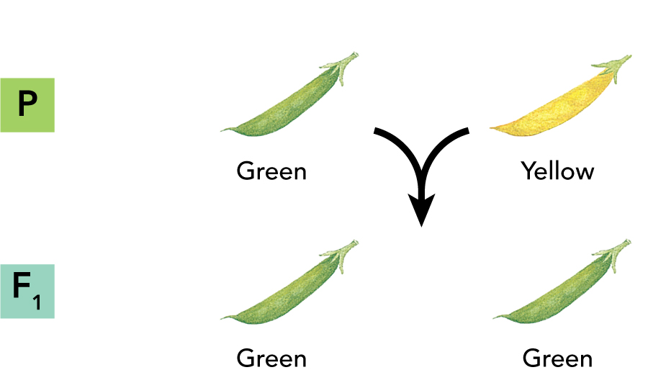
The F₁ Generation
P parent
F₁ offspring
Notes:
Explain that a big question for Mendel was whether a recessive trait disappeared once it was masked by a dominant trait.
Make sure students understand how to read this diagram representing crosses of plants.
Ask: Where in the diagram are the parent plants?
Answer: the plants in the top row
Ask: What are the plants in the bottom row?
Answer: the offspring generation
Have a volunteer go to the board to label the “P” and “F1” generations.
Click to reveal the correct answers.
Ask: Based on the diagram for this cross, which trait is dominant: green color or yellow color?
Answer: green color
Ask: If you only saw the plants in the F1 generation, could you know for sure what the parents’ colors are? Why or why not?
Answer: No, tall pea plants could have one green color and one yellow color parent or two green color parents.

Slide 12
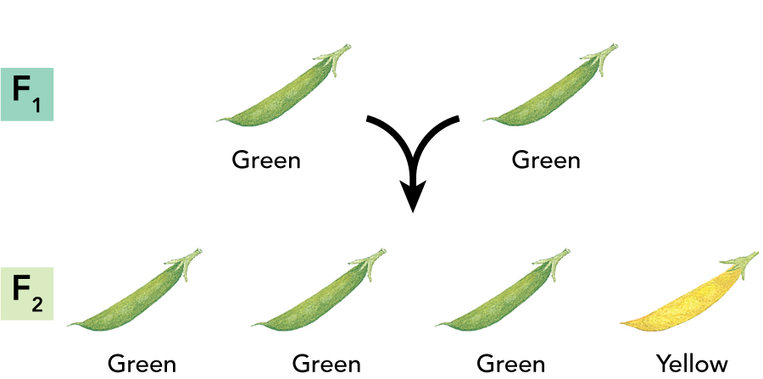
The F₂ Generation
What proportion of F₂
offspring were short?
What proportion of F₂
offspring were tall?
1/4
3/4
Notes:
Remind students that Mendel wanted to see what would happen to traits that were seemingly “masked” in the F1 generation. To address this question, he created another generation, crossing F1 plants with themselves (essentially self-pollination) to produce the next generation, called F2.
Walk through the diagram with students.
Ask: How does the color of the plants in the F1 generation compare to the colors of the plants in the F2 generation?
Answer: All the plants in F1 were green, but not all F2 plants were green.
Ask: What is the relationship between the P generation and the F2 generation?
Answer: The P generation are the grandparents to the F2 generation.
Misconception Alert: Students may think when they see diagrams such as the one here that the cross involved only two parents and exactly four offspring were produced. Make sure students understand that Mendel crossed many plants in each generation, and that the “four” offspring represented here in the F2 generation just represent the relative proportion of offspring in that generation having the particular trait.
Ask students to answer the questions on the screen.
Click to reveal the correct responses.
Ask: Suppose the F2 generation contained 100 individual plants. How many would you expect to be green?
Answer: about 75

Slide 13
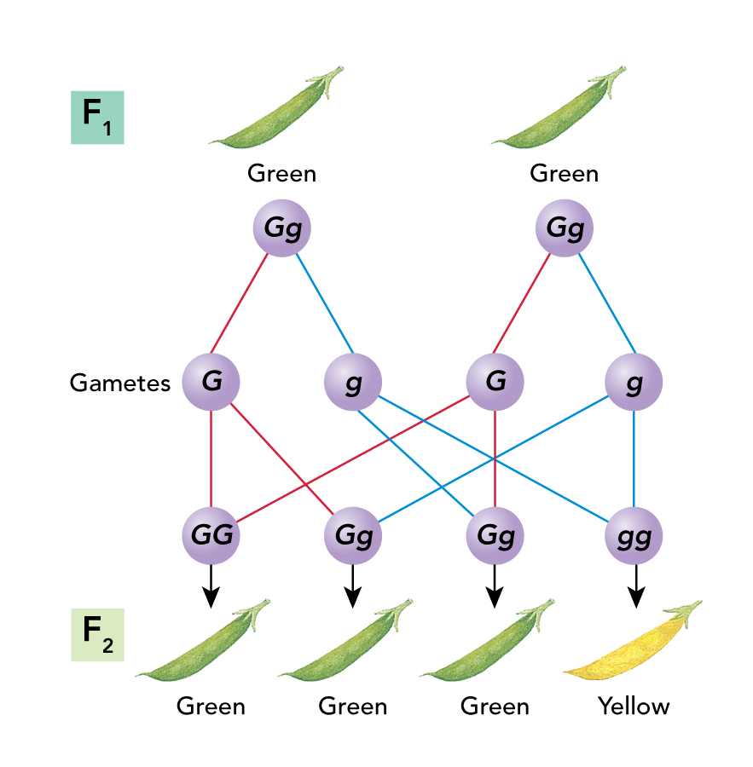
The Formation of Gametes
Eggs and sperm
Fertilization
Notes:
Explain that during formation of gametes, or sex cells, alleles segregate from each other so that each gamete carries only a single copy of (one allele for) each gene.
Have a volunteer go to the board to point out (or to respond verbally) what portion of the diagram represents eggs and sperm.
Click to reveal the eggs and sperm label and circle.
Ask: When do the gametes join up again to form allele pairs?
Answer: at fertilization
Have a volunteer point out (or indicate verbally) what portion of the diagram represents fertilization.
Click to reveal the fertilization label and rectangle.
Make sure students understand the results of the F2 generation by tracing the inheritance pattern. Point out how the F1 gametes segregated to produce new combinations of alleles in the F2 plants.
Challenge students to imagine gamete formation in the F2 generation.
Ask: For each of the 4 F2 plants shown, how many kinds of gametes could each produce?
Answer: (from L to R) 1, 2, 2, 1

Slide 14
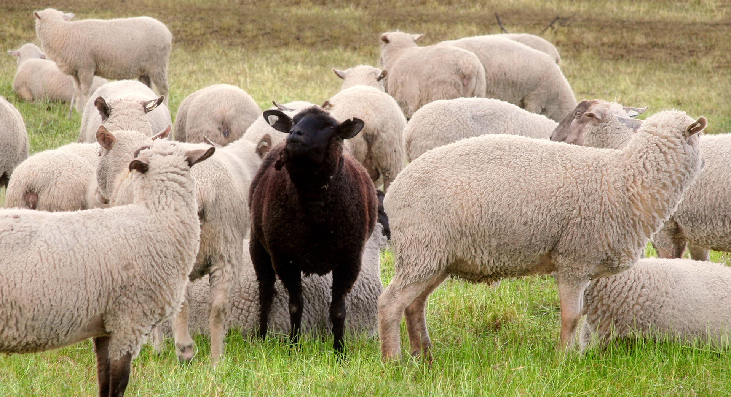
Applying Mendel’s Principles
Notes:
Read the lesson title aloud to students.

Slide 15
Learning Objectives
Explain how probability can be used to predict inherited traits.
Explain how alleles segregate when more than one gene is involved.
Identify Mendel’s contributions to our understanding of genetics.
Notes:
Click to reveal each of the learning objectives. Read the statements or ask a volunteer to do so.

Slide 16
Probability and Heredity
Probability: the likelihood an event will occur. If you flip a coin, what is the
probability of either outcome:
Three coin tosses?
Each flip is an independent event.
50% or 1/2
1/2 × 1/2 × 1/2 = 1/8
Notes:
Ask: Suppose you toss a coin. What is the probability of the coin landing on tails? Landing on heads?
Answer: 50%, or ½, for each
Click to reveal correct answer.
Ask: What is the probability of a coin toss landing on tails three flips in a row?
Answer: 1/8
Invite a volunteer to come to the board to write out the appropriate equation.
Click to reveal the correct equation and answer.
Emphasize that being independent means that the outcome of one coin toss does not affect the outcome of another. So no matter how many times you flip the coin, the probability of the next toss landing on either outcome is 50%, or ½.

Slide 17
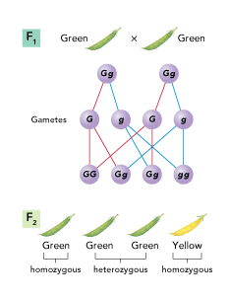
Using Segregation to Predict Outcomes
Probability of a gamete receiving a G?
Probability of gamete receiving a g?
Probability of green offspring is
.
Probability of yellow offspring is
.
50%, or 1/2
50%, or 1/2
3/4
1/4
Notes:
Point out that both F1 plants have the same set of alleles and are tall.
Explain that in the cross shown here, the GG and Gg allele combinations produced three green pea plants, while the gg allele combination produced one yellow plant. These quantities follow the laws of probability.
Walk students through the steps as shown on screen.
Ask for volunteers to fill in the blanks either verbally or by writing in the correct response.
Click to reveal the correct responses in turn.
Ask: If you crossed a GG plant with a Gg plant, would the offspring be green or yellow?
Answer: All would be green (GG or Gg).
To explain how probability principles work in genetic crosses, model the cross shown in in the diagram here. Write Gg on the board and draw a circle around it to represent the cell of one of the parents in the figure. Draw 10 gamete circles under the parent cell. Then draw an arrow from the parent cell to each gamete.
To determine which allele (G or g) will go in each gamete circle, flip a coin. Tell students that heads represents the dominant allele (G ) and tails represents the recessive allele (g ). As you fill in each circle, flip the coin and repeat that the probability of a G or a g going to a gamete is one in two, or 1/2. Emphasize that each event is random and independent of the others and that probability predicts outcomes; it does not guarantee them.
Then do the same with another parent cell. Show two gametes joining and explain that this event also is random and independent. Therefore, the probability of an F2 cell having a particular combination of alleles is found by multiplying 1/2 × 1/2.

Slide 18
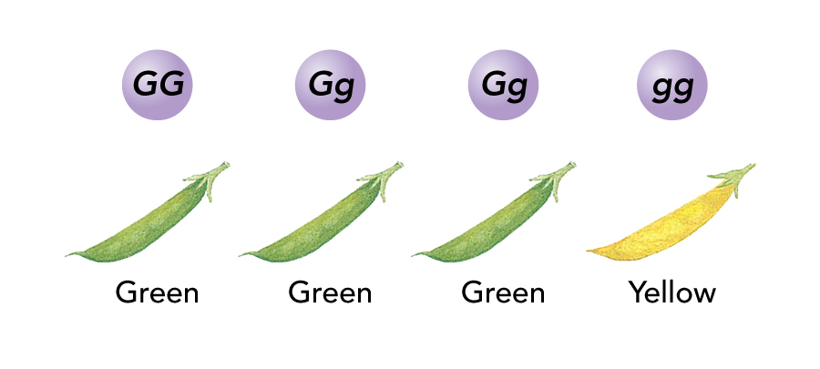
Genotype and Phenotype
Genotype: genetic makeup
Phenotype: physical traits
phenotype
Two organisms may share the same
but have different .
genotypes
Notes:
Ask: What are the two possible genotypes of a green plant?
Answer: GG and Gg
Ask: What is the phenotype of a plant that has two alleles for yellow color?
Answer: yellow
Ask students what terms correctly fill in the blanks. Have a student volunteer read the statement.
Click to reveal the correct answers.

Slide 19
Heterozygous and Homozygous
Homozygous: has two identical alleles for a gene
Heterozygous: has two different alleles for a gene
Which are:
homozygous? heterozygous?
1, 4
2, 3
1
2
3
4
Notes:
Discuss the definitions of homozygous and heterozygous.
Ask: Which of these plants is homozygous for the height characteristic? Which of these plants is heterozygous for the height characteristic?
Click to reveal the correct answers.
Then challenge students to combine this terminology with what they have learned about dominant and recessive alleles.
Ask: Which of these plants is homozygous dominant?
Answer: 1
Ask: Which of these plants is homozygous recessive?
Answer: 4

Slide 20
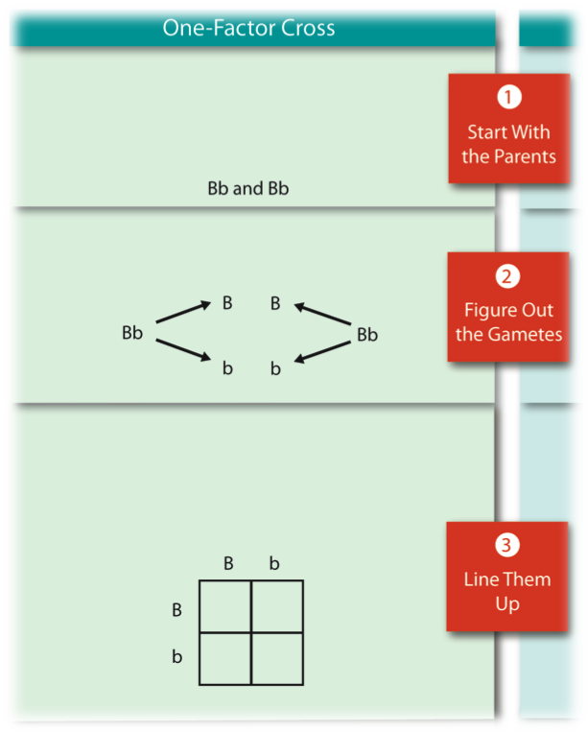
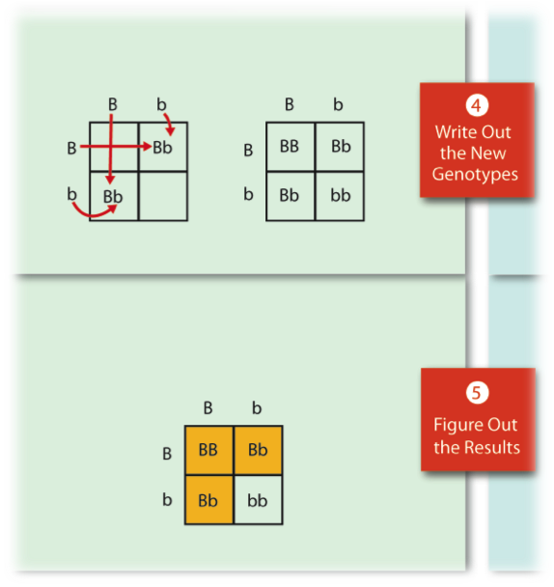
Making a Punnett Square
A cross of ospreys:
beak size (B, b)
Combine gamete genotypes
Possible gametes
Gametes for a parent
along one side
Notes:
Explain that one of the best ways to predict the outcome of a particular cross is to use a model called a Punnett square. Emphasize that Punnett squares use mathematical probability to help predict the genotype and phenotype combinations in genetic crosses.
Have students identify the alleles each parent could pass on to offspring (Bb and Bb). Walk through each column and row to make sure students understand how the alleles combine. Point out that combinations are simply pairings of the allele carried by either the male or female gamete from a particular row and column. In step 5, remind students that a Punnett square identifies possible gene combinations and that actual combinations could be different. Then call on volunteers to explain each step in the two-factor cross. Give the class practice problems in making and completing both types of Punnett squares.
Have students interpret the final Punnett square.
Ask: Are the parent homozygous or heterozygous?
Answer: Heterozygous
Ask: How many different genotypes are possible for offspring? How many different phenotypes?
Answer: 3 genotypes, 2 phenotypes
Ask: What is the probability that an offspring from this cross will have the dominant phenotype?
Answer: ¾
Ask: What is the probability that an offspring from this cross will have the recessive phenotype?
Answer: ¼

Slide 21
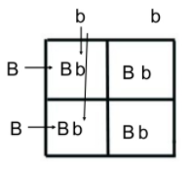
Practice problem
A blue faced Oompah Loompa (homozygous) is married to an oranged faced Oompah. They have 8 children. How many children will have blue faces? (Blue is dominant)

Slide 22
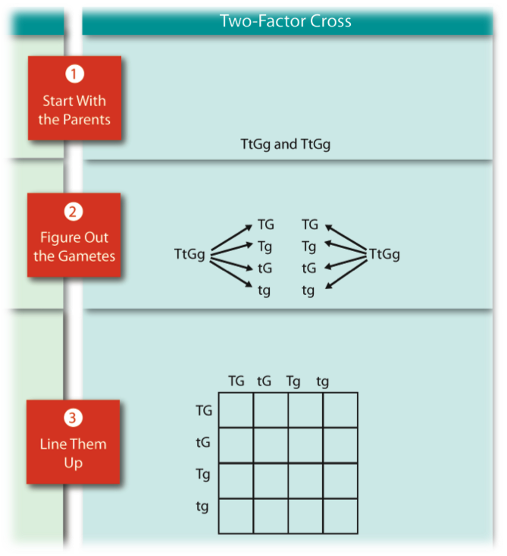
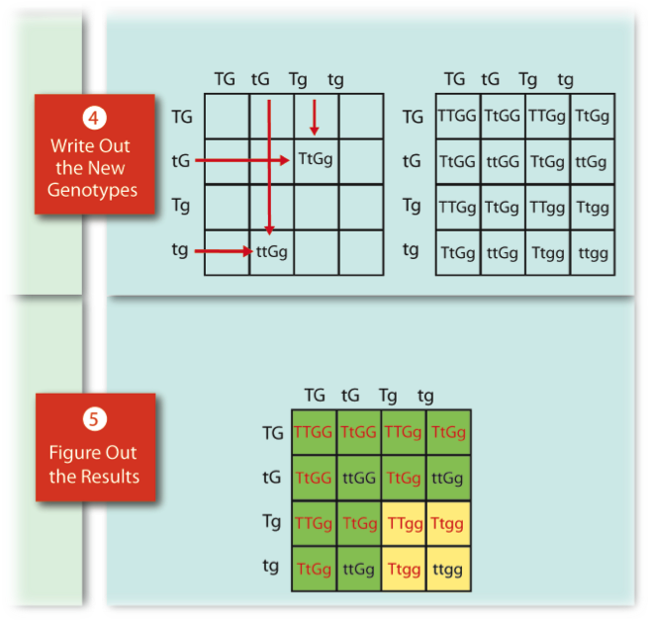
Making a Punnett Square: Two Factors
A cross of pea plants:
size (T, t) and pod color (G, g)
Combine gamete genotypes
All possible gametes
All gametes for a parent
along one side
Notes:
Point out that it is possible to look at more than one characteristic at a time with a Punnett square. When you focus on two characteristics at a time, it is called a dihybrid cross.
In a similar manner as in the previous slide, walk students through the diagram explaining how to make a Punnett square for a dihybrid cross.

Slide 23
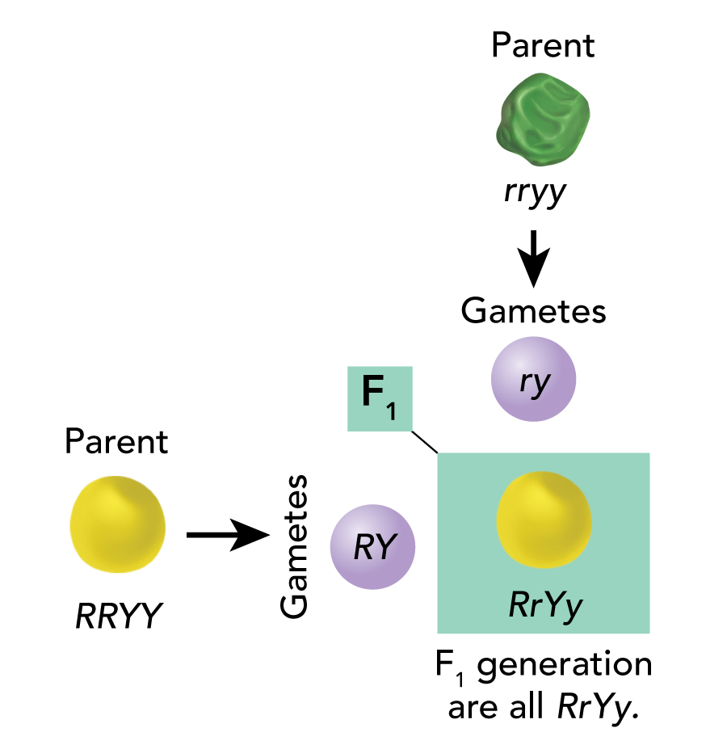
The Two-Factor Cross: F₁
RRYY
Notes:
Point out that after Mendel showed that alleles segregate during the formation of gametes, he still wondered if the segregation of one pair of alleles affected another. To find out, he followed two different genes—for pea color and pea shape—from one generation to the next.
Tell students that this Punnett square represents a “dihybrid cross” because it involves two different traits: seed shape and color. Round is dominant over wrinkled, and yellow is dominant over green.
Ask: How is the genotype of the offspring different from that of the homozygous parent?
Answer: The offspring are heterozygous for both traits.
Ask: What is the phenotype of each parent? What is the phenotype of the offspring?
Answer: One parent produces round yellow seeds, and the other produces green wrinkled seeds. The offspring all produce round yellow seeds.
Challenge students to predict offspring genotypes and phenotypes in the F2 generation.
Ask: Is the F1 generation is crossed with itself, what are the genotypes of the parents?
Answer: Both parents would be RrYy (heterozygous).
Ask: Will it be possible for there to be homozygous recessive offspring in the F2 generation? How do you know?
Answer: Yes, because it is possible for each parent to contribute the recessive allele for each trait to an offspring.

Slide 24

Practice Problem
Cross two plants with genotype RrYy.
RY
Ry
rY
ry
RY
Ry
rY
ry

Slide 25
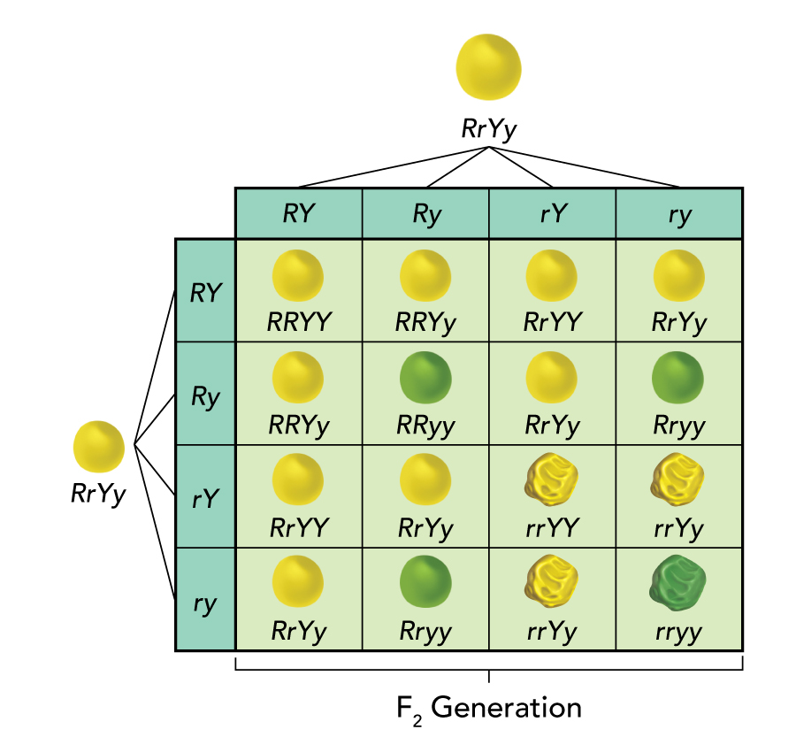
The Two-Factor Cross: F₂
Independent assortment: Genes for different traits can segregate independently during gamete formation.
9:3:3:1 ratio of phenotypes
Notes:
Have a student volunteer come to the board to point out the homozygous recessive offspring.
Click to reveal the circle around the homozygous recessive offspring.
Have students interpret aspects of this Punnett square.
Ask: How many different phenotypes are present in the offspring?
Answer: 4
Ask: What is the probability of a cross of these parents producing a fully homozygous recessive offspring for these two traits?
Answer: 1/16
Click to reveal the circle around the rryy individual
Ask: What proportion of offspring are likely to have the phenotype dominant for yellow and the recessive for wrinkled seeds?
Answer: 3/16
Ask: What proportion of offspring are likely to have the phenotype dominant for round and recessive for green seeds?
Answer: 3/16
Click to reveal square around the RRyy individual.
Ask: How many different kinds of gametes could this individual produce? What are they?
Answer: 1; Ry
Ask: What proportion of offspring are likely to have the dominant phenotype for both traits?
Answer: 9/16
Ask: What ratio of phenotypes does this Punnett square predict?
Answer: 9:3:3:1
Click to reveal the ratio.
Ask: What evidence did Mendel have that alleles segregated independently in the cross shown here?
Answer: All combinations of phenotypes resulted.
Ask: What phenotypes would have resulted if the alleles did not segregate independently—in other words, if the RY always stayed together and the ry always stayed together?
Answer: round, yellow seeds and wrinkled green seeds
Direct students’ attention to the definition of the principle of independent assortment.

Slide 26
Summary of Mendel’s Principles, Part I
Inheritance is determined by units called , which are passed from parents to offspring.
Where more than one form of a gene for a single trait exists, some alleles may be and others .
genes
dominant
recessive
Notes:
Emphasize that Mendel’s principles of heredity, observed through patterns of inheritance, form the basis of modern genetics.
Ask for a volunteer to verbally identify the terms that complete each sentence.
Click to reveal the correct answers.

Slide 27
Summary Mendel’s Principles, Part II
Each adult has two copies of each gene—one from each parent. These genes from each other when gametes are formed.
Alleles for different genes usually segregate of each other.
segregate
independently
Notes:
Remind students that Mendel’s principles apply to sexually reproducing organisms.
Ask for a volunteer to verbally identify the terms that complete each sentence.
Click to reveal the correct answers.

Slide 28
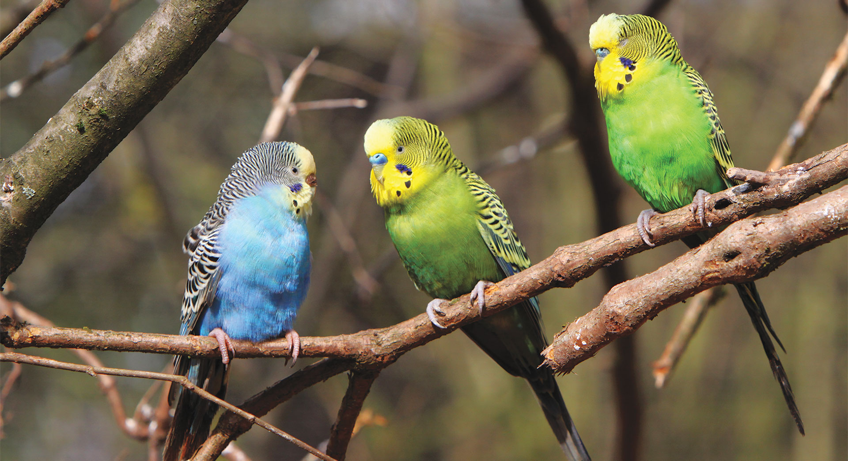
Other Patterns of Inheritance
Notes:
Read the lesson title aloud to students.

Slide 29
Learning Objectives
Describe some of the exceptions to Mendel’s principles.
Explain the environment’s role in the way genes determine traits.
Notes:
Point out that when Mendel examined characteristics of pea plants, he was fortunate in that the particular characteristics were each controlled by a single gene, each of which had two alleles. Tell students to think about all the different shades of hair color that humans have. Then ask if they think that hair color is controlled by just one gene. Lead students to conclude that there is likely more than one gene responsible for human hair color.
Click to reveal each objective in turn. Read the objectives aloud or have a volunteer do so.
Tell students by the end of this presentation they will understand some categories of exceptions to Mendel’s principles and will be able to describe the relationship between an organism’s genes and its environment.

Slide 30
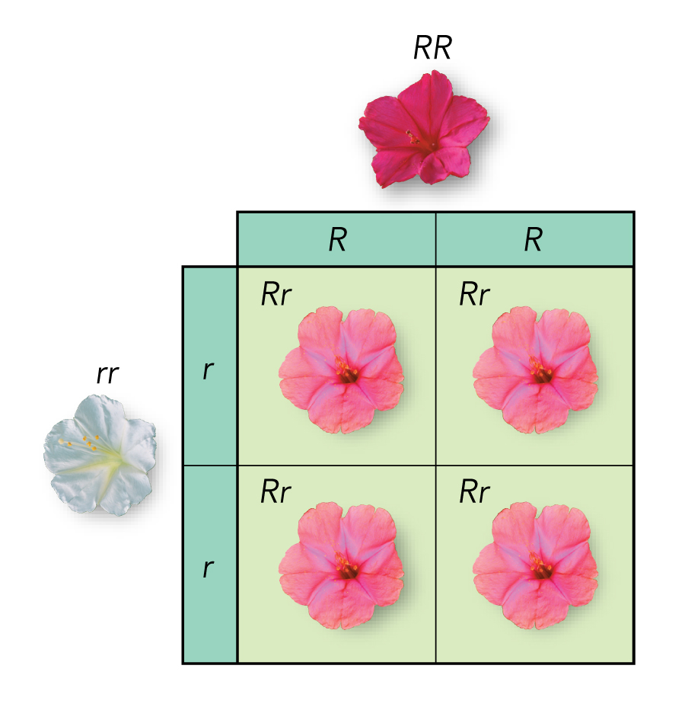
Incomplete Dominance
Some alleles are neither dominant nor recessive.
Incomplete dominance: One allele is not completely dominant over another.
Notes:
Review with students the definitions of dominant and recessive.
Explain that four o’clock plants, whose flowers are shown here, have genes for flower color that don’t follow the strict dominance pattern that Mendel saw in different characteristics of pea plants. In four o’clock plants, the alleles for red and white flowers show incomplete dominance. Heterozygous (RR ) plants have pink flowers—a mix of red and white coloring.
Ask: Are the parent plants homozygous or heterozygous for flower color?
Answer: homozygous.
Ask: Are the offspring homozygous or heterozygous for flower color?
Answer: heterozygous
Ask: Could plants with pink flowers produce any offspring with red flowers?
Answer: Yes; each parent could give an “R” allele for flower color to an offspring, which would make that offspring homozygous for red flowers.

Slide 31
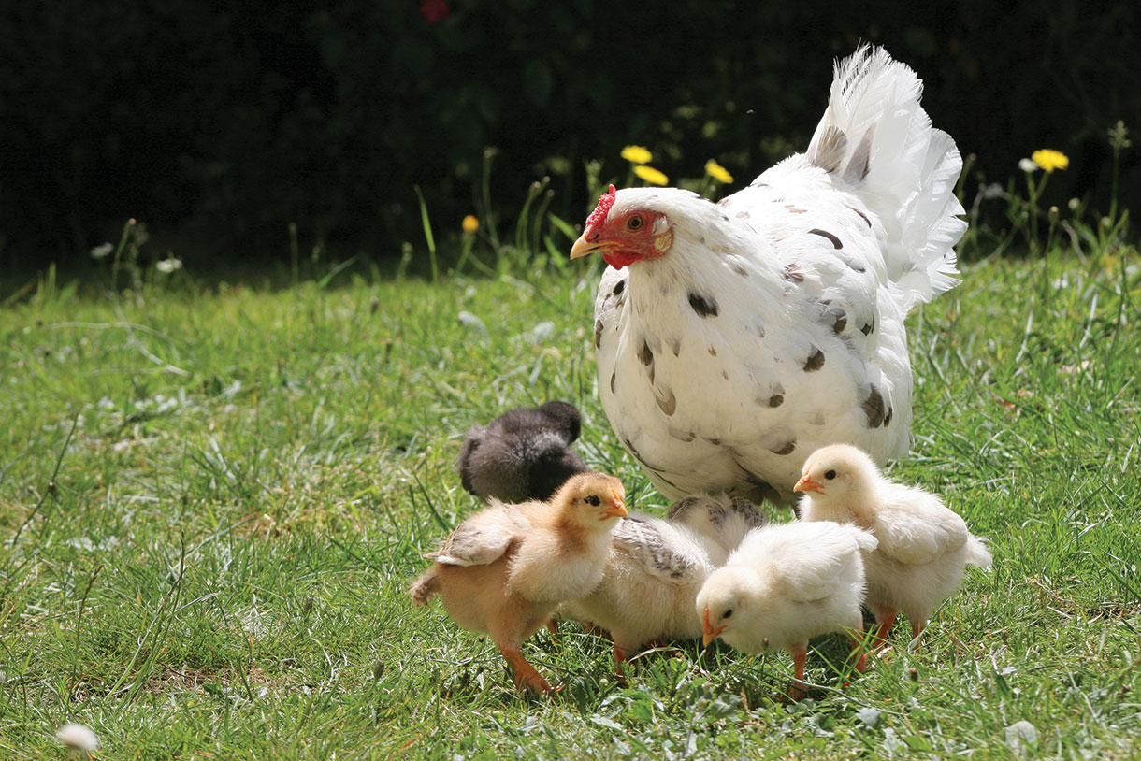
Codominance
The phenotypes for both alleles are clearly expressed.
Examples: chicken feather color, human protein controlling blood cholesterol levels
Notes:
Explain that in codominance, the phenotypes produced by both alleles are clearly expressed. In some varieties of chicken, the allele for black feathers is codominant with the allele for white feathers.
Heterozygous chickens have a color described as “erminette,” speckled with black and white feathers.
Ask: How is incomplete dominance different from codominance?
Answer: In incomplete dominance, the traits are blended. In codominance, both traits are distinctly expressed.

Slide 32
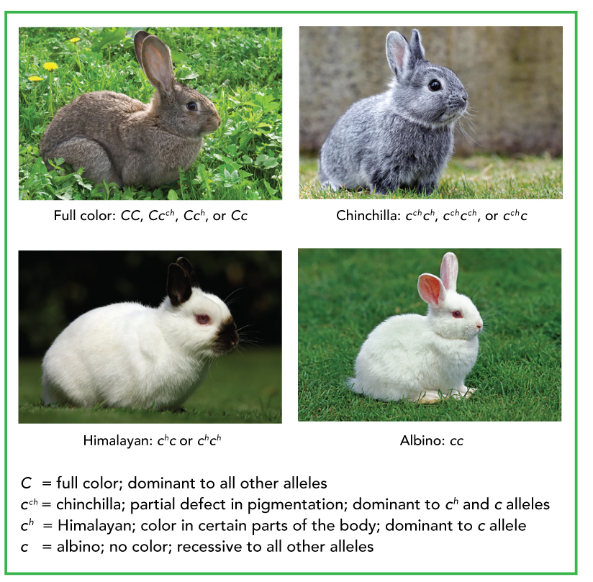
Multiple Alleles
Many genes exist in more than two forms.
Examples: human blood types, fur color in rabbits
Notes:
Students are likely familiar with the concept of blood types. Ask them to identify the blood types they know. Explain that there being more than two alleles for a gene is common in a population. Make sure students understand, though, that any given individual in this population will have only two of those alleles.
Point out that in the case of human blood types, some alleles also show codominance. Tell students that the A and B alleles are codominant. A and B are each dominant over O. Explain that the Rh factor is inherited independently of the blood type alleles. Rh+ is dominant over Rh−.
To illustrate further how a gene can exist in more than two forms, write the symbols for four alleles for rabbit coat color on the board in order from the most dominant to the least dominant: C = full color, Cch = chinchilla color, Ch = Himalayan color, c = albino (no color). Have students make up genetic crosses for coat color in rabbits. If desired, have them exchange their proposed crosses with a partner who can then use Punnett squares to solve the problems.

Slide 33
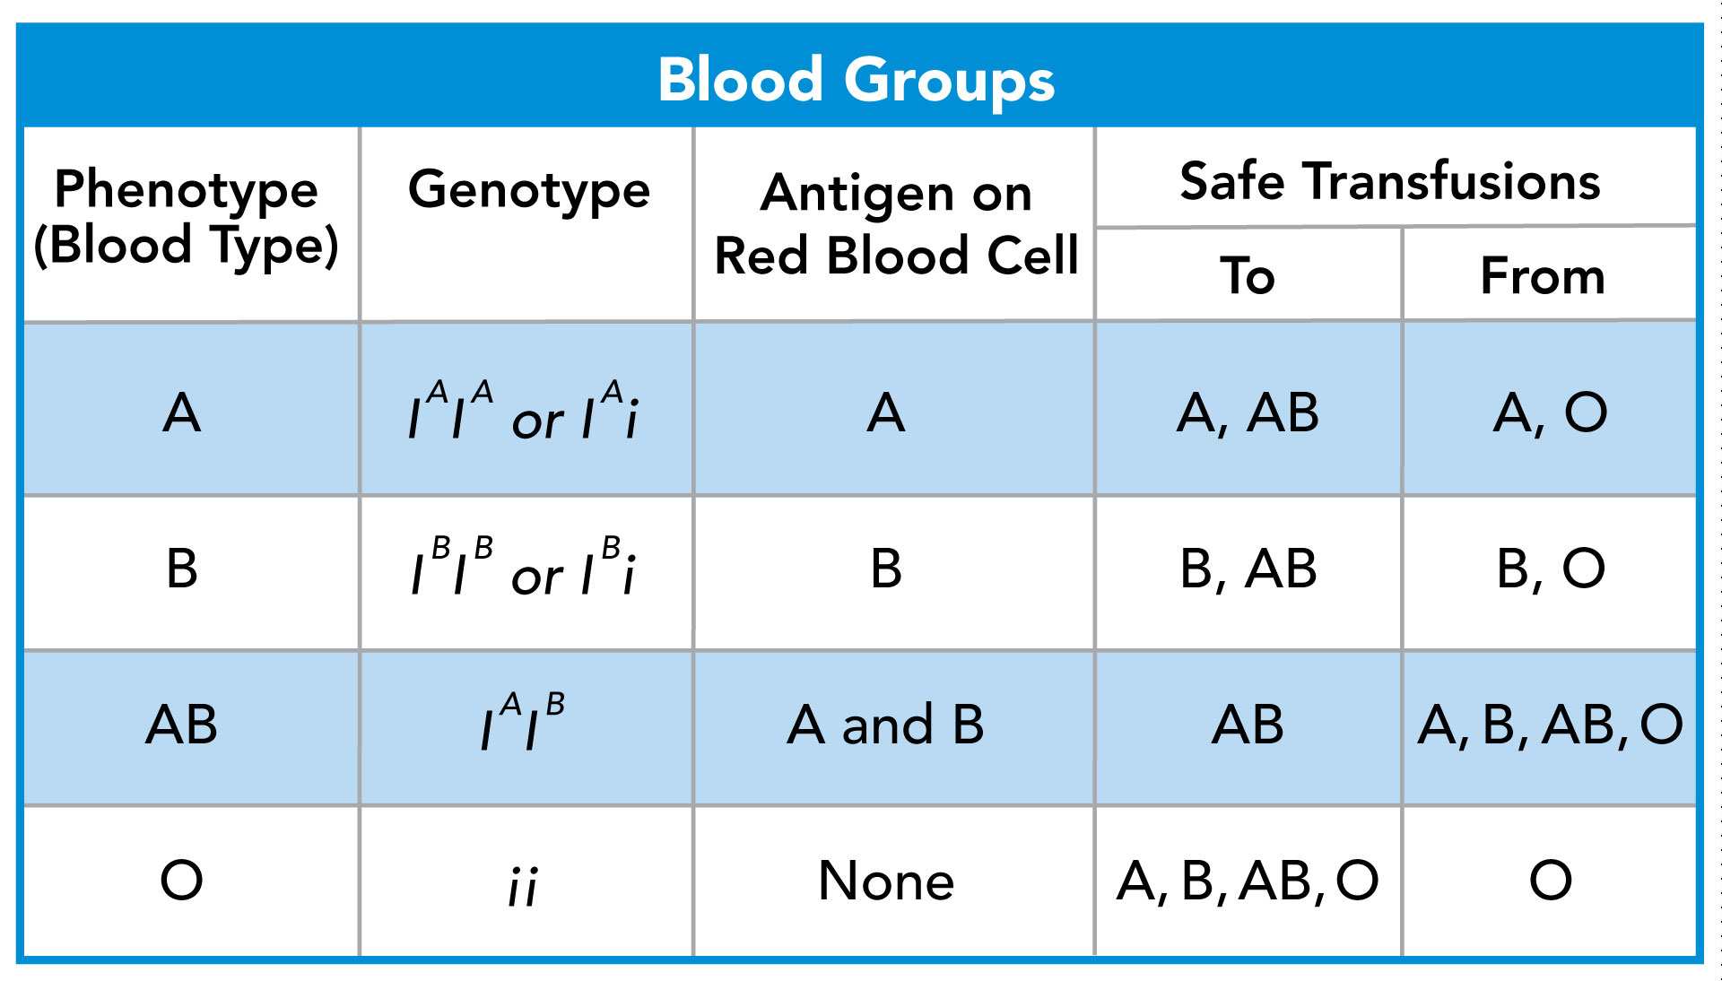
Codominant and Multiple Alleles
Notes:
Tell students: One example of codominant inheritance is the ABO blood group, which is determined by a gene with three alleles: I^{A}, I^{B}, and i.
Alleles I^{A} and I^{B} are codominant.
These genes code for proteins known as antigens on the surface of red blood cells.
Ask for a volunteer to identify an individual on the Blood Groups chart with both alleles I^{A} and I^{B}.
Click to verify the volunteer’s selection.
Tell students: Individuals with both alleles produce both A and B antigens.
Click to highlight the antigens.
Tell students: This makes the individuals’ blood type AB.
Click to highlight the blood type.
Tell students: The i allele is recessive.
Individuals with alleles I^{A}I^{A} or I^{A}i produce only the A antigen, making them blood type A.
Click to highlight the blood type.
Ask: If an individual has I^{B}I^{B} or I^{B}i alleles, what blood type is that individual?
Answer: blood type B
Click to validate the answer.
Tell students: Those individuals who are homozygous for the i allele (ii) produce no antigen and are said to have blood type O.
Click to highlight the blood type.
Ask: Why are there only four different phenotypes when there are six different genotypes?
Answer: The allele for no antigens, i, is recessive to I^{A} and I^{B}. Thus, two different genotypes—I^{A}I^{A} and I^{A}i—result in the A phenotype, and two other genotypes—I^{B}I^{B} and I^{B}i—result in the B phenotype.

Slide 34
Polygenic Traits
Many traits are produced by the interaction of several genes.
Examples: eye color in fruit flies, coat color in dogs
Traits typically show a wide variety of phenotypes.
Notes:
Define polygenic traits for students: Polygenic traits are produced by the interaction of several genes.
Ask: How are multiple alleles different from polygenic traits?
Answer: Multiple alleles refers to different forms (alleles) for a single gene. Polygenic traits refers to multiple genes influencing a single trait.
Misconception Alert: Many students think that one gene is always responsible for one trait. Explain that such a case is actually rare. Most traits—such as hair and eye color in humans—are influenced by multiple genes.

Slide 35
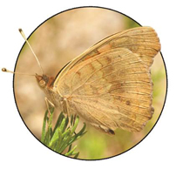
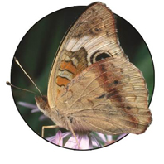
Genes and the Environment
Environmental conditions can affect gene expression and influence genetically determined traits.
The of an organism is only partly
determined by its .
phenotype
genotype
Notes:
Describe the example of the western white butterfly, which is found throughout western North America. Some people noticed over the years that western whites hatching in the summer had different color patterns on their wings than those hatching in the spring. Scientific studies showed the reason: Butterflies hatching in the shorter days of springtime had greater levels of pigment in their wings, making their markings appear darker than those hatching in the longer days of summer. In other words, the environment in which the butterflies develop influences the expression of their genes for wing coloration. Point out that pictures here are of buckeye butterflies, which show a similar pattern: They are darker in the summer than in the autumn.
Explain that the characteristics of any organism—whether plant, fruit fly, or human being—are not determined solely by the genes that organism inherits. Genes provide a plan for development, but how that plan unfolds also depends on the environment.
Ask for a volunteer to fill in the blanks verbally, reading the complete sentence.
Click to reveal the correct terms.
Ask students to consider in the case of the butterflies why being darker in the autumn than in the summer be useful. Explain that in order to fly effectively, the body temperature of the butterfly must be 28°C–40°C (about 84°F–104°F). Because the spring months are cooler in the West, greater pigmentation helps them reach the body temperature needed for flight. Similarly, in the hot summer months, less pigmentation enables the moths to avoid overheating.
Point out that “environment” refers to internal factors, too. For example, both men and women can have the genes for male pattern baldness, but baldness shows up more often in men because male hormones trigger the expression of the gene.

Slide 36

Human Chromosomes
Notes:
Read the lesson title aloud to students.

Slide 37
Learning Objectives
Describe how human karyotypes are used.
Explain the patterns of the inheritance that human traits follow.
Identify how pedigrees can be used to analyze human inheritance.
Notes:
Click to show each of the learning objectives.
Ask: Do you know what a dog pedigree is?
Answer: A pedigree is a record of the family tree that typically includes at least three generations.
Explain that a pedigree is often used to show a dog is a purebred, and it gives information about the dog’s background and any hereditary health problems in its bloodline.
Tell students: Human pedigrees also are used to show information about a person’s background, and can be used to trace genetic disorders.
Tell students: At the end of the presentation, you will be able to identify types of human chromosomes in a karyotype, describe patterns of inheritance of human traits, and explain how pedigrees are used to study human traits.

Slide 38
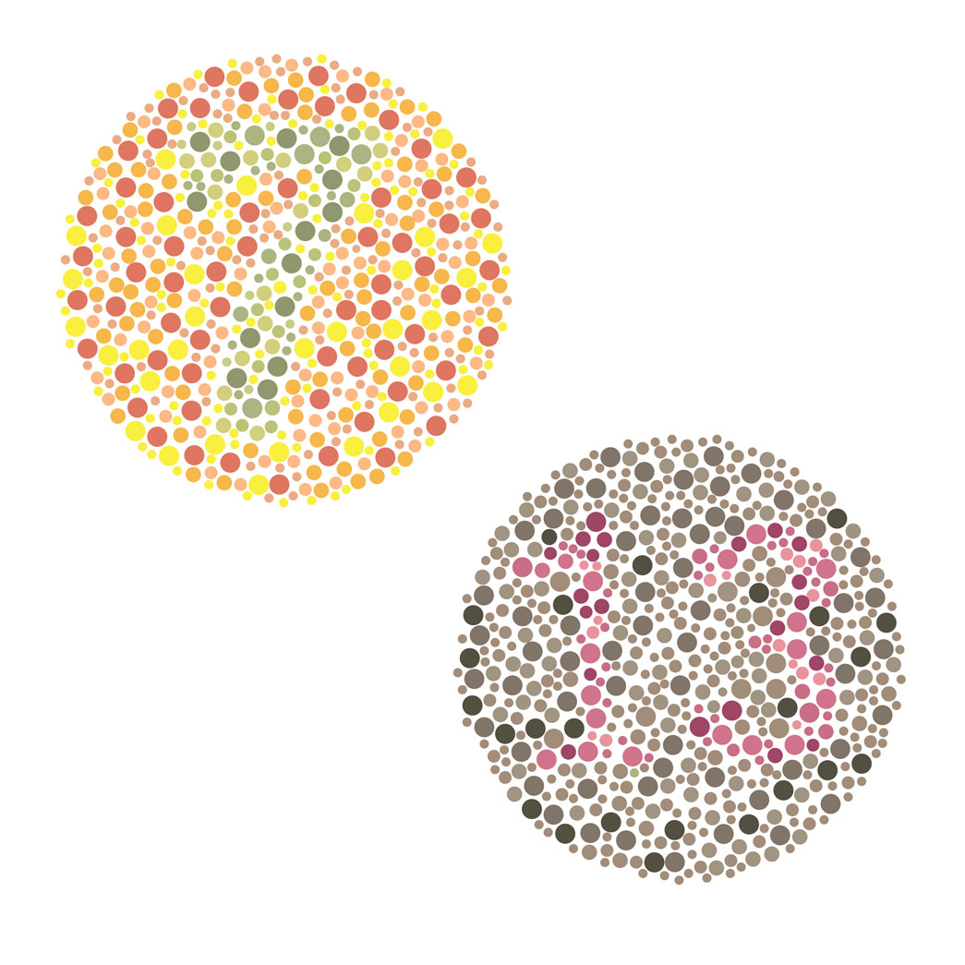
Sex-Linked Inheritance
The X and Y chromosomes determine sex.
The genes located on them show sex linkage.
Colorblindness is a sex-linked trait
Notes:
Tell students: A sex-linked gene is a gene located on a sex chromosome.
Genes on the Y chromosome are found only in males and are passed directly from father to son.
Genes located on the X chromosome are found in both sexes.
Help students explore sex-linked inheritance by examining a specific cross involving colorblindness. Tell students that doctors use images like the ones shown to test for colorblindness.
Have students construct a Punnett square to show a cross between a father with normal vision and a mother who is a carrier of the colorblindness trait.
Tell students to use the symbols X^{B} to represent the dominant allele on the X chromosome and X^{b} for the recessive one.
Ask: What percent of the children have normal vision?
Answer: 75 percent
Ask: Are both daughters carriers? Explain.
Answer: No, only one daughter has the X^{b} allele.

Slide 39
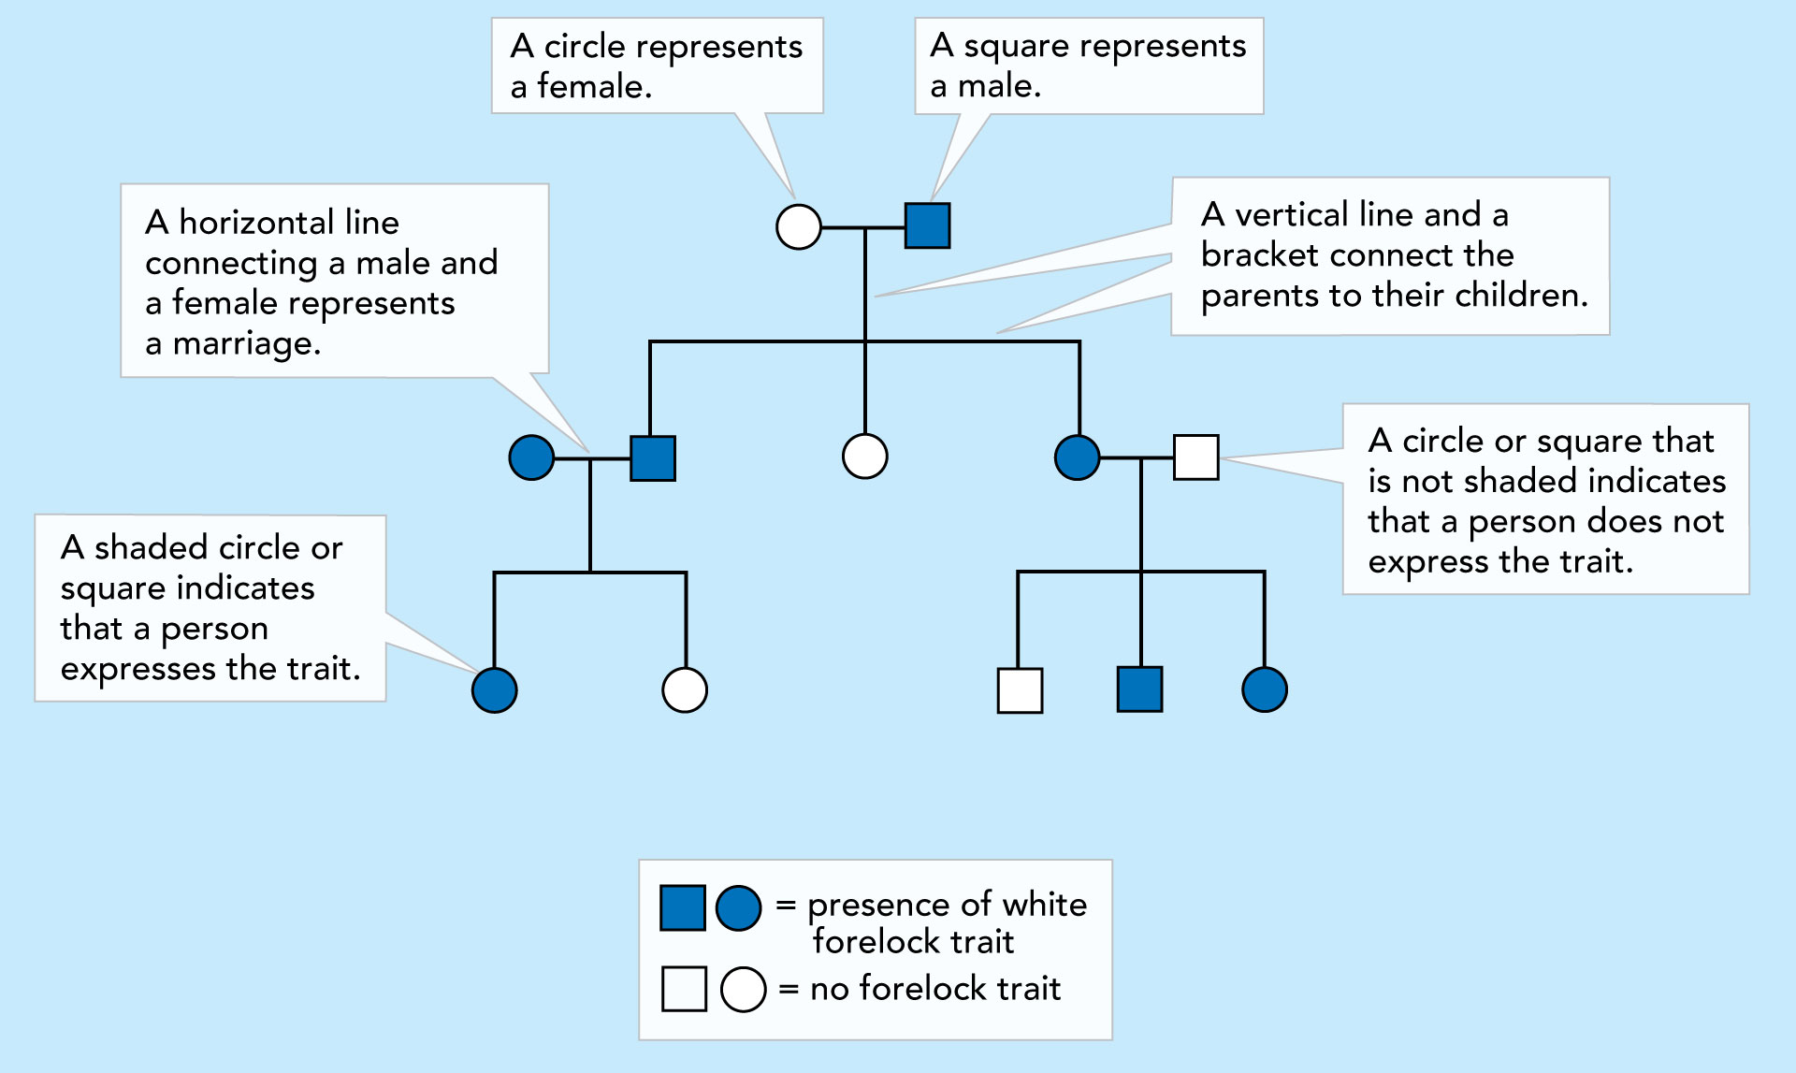
Human Pedigrees
A pedigree chart shows the relationships within a family.
Notes:
Ask: Given the complexities of genetics, how would you go about determining whether a trait is caused by a dominant or recessive allele and whether the gene for that trait is autosomal or sex-linked?
Answer: by applying Mendel’s basic principles of genetics
Ask: How would you analyze the pattern of inheritance followed by a particular trait?
Answer: You can use a chart that shows the relationships within a family. Such a chart is called a pedigree.
A pedigree shows the presence or absence of a trait according to the relationships among parents, siblings, and offspring.
It can be used for any species, not just humans.
Tell students: In a pedigree chart, a circle represents a female and a square represents a male. A horizontal line connecting a male and a female represents a marriage and a vertical line and a bracket connect the parents to their children. Last, tell them that a shaded circle or square indicates that a person expresses the trait, while one that is not shaded indicates that a person does not express the trait.

